Slide 1
Cardiovascular Health Risk Factors DSCI-511
Presented by:
Roy Phelps, Shad Scarboro, Leland Weeks, Evan Wessel

Slide 2
Introduction and Purpose
In-depth analysis of cardiovascular risk factors (demographics, health vitals, activities)
Specific to provinces across China
Dataset structure
Goals

Slide 3
Team Members
Roy Phelps (rp994@drexel.edu)
Skills: Python, Jupyter Notebooks, Documentation, Data cleaning and visualization
Targeted Growth Skills: Data cleaning with better Python code
Contributions: Code development, documentation, Git/GitHub organization
Shad Scarboro (srs359@drexel.edu)
Skills: Python, Data sourcing, Data integration, Data cleaning and visualization
Targeted Growth Skills: Documentation
Contributions: Code development, Data acquisition, Documentation
Leland Weeks (lhw22@drexel.edu)
Skills: Product Management, Data sourcing, Business Intelligence
Targeted Growth Skills: Big Data, Data Mining, Predictive Analytics
Contributions: Data selection, Data cleaning, Project coordination
Evan Wessel (ew594@drexel.edu)
Skills: Writing, Data summaries, Research, Organization
Targeted Growth Skills: Python, Data acquisition and cleaning
Contributions: Data selection, Data summaries, Presentation material

Slide 4
Data Source of Interest
Kaggle.com
OpenAQ.org
WHO Global Health Observatory
Open Street Maps

Slide 5
Data Acquisition
Kaggle.com
Heart_attack_china.csv
CSV download
OpenAQ.org
Air quality data
API
WHO Global Health Observatory
Blood pressure info
CSV via API
Open Street Maps
GIS data
API

Slide 6
Approach to Preprocessing -From raw sources to analysis-ready data
Combined multiple sources into a single patient-level dataset (Kaggle heart attack data, air quality, WHO blood pressure, and province geography)
Standardized key identifiers and province information (cleaned text, aligned province names, and unified units)
Engineered clinical and lifestyle flags (e.g., hypertension, smoking, and activity indicators converted to consistent 0/1 flags)
Converted ordered text responses into numeric categories (so models and summaries can treat “low / medium / high” responses correctly)
Produced three curated outputs
Analysis-ready table
Model-ready table
Merged dataset with WHO context
Raw sources
Preprocessing
Flags & encoding
Final outputs
Notes:
Our preprocessing goal was to take several raw sources and turn them into a single, consistent dataset we could trust.
First, we combined the Kaggle heart attack data with external context from air quality, WHO blood pressure information, and province-level geography, so that everything was aligned at the patient and province level.
We then standardized key identifiers and province names, cleaned text fields, and made sure units and formats were consistent across sources.
After that, we engineered clinical and lifestyle flags such as hypertension, smoking, and activity indicators and converted ordered text responses into numeric categories that are easier for models to use.
Finally, we produced three curated outputs: an analysis-ready table, a model-ready table, and a merged dataset with WHO context that we can reuse for both visualization and future modeling work.

Slide 7
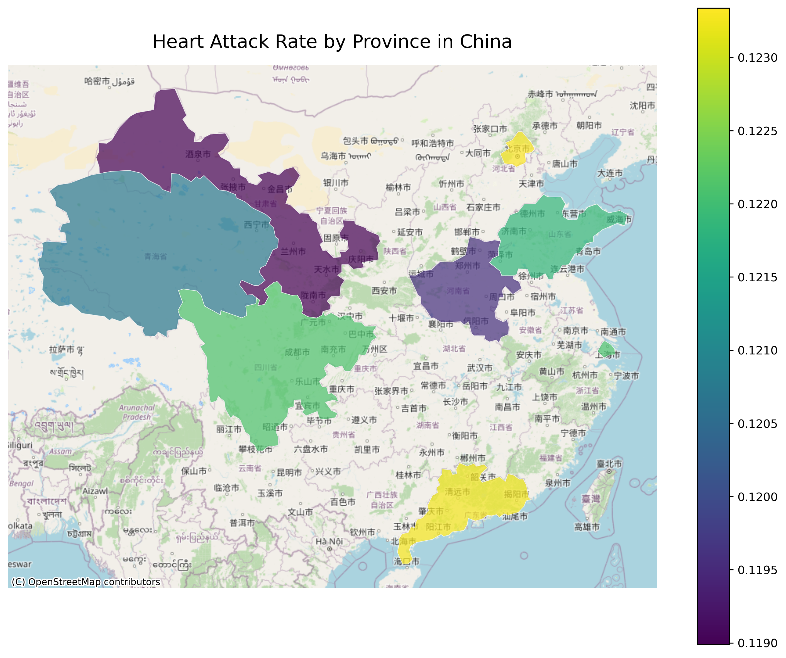
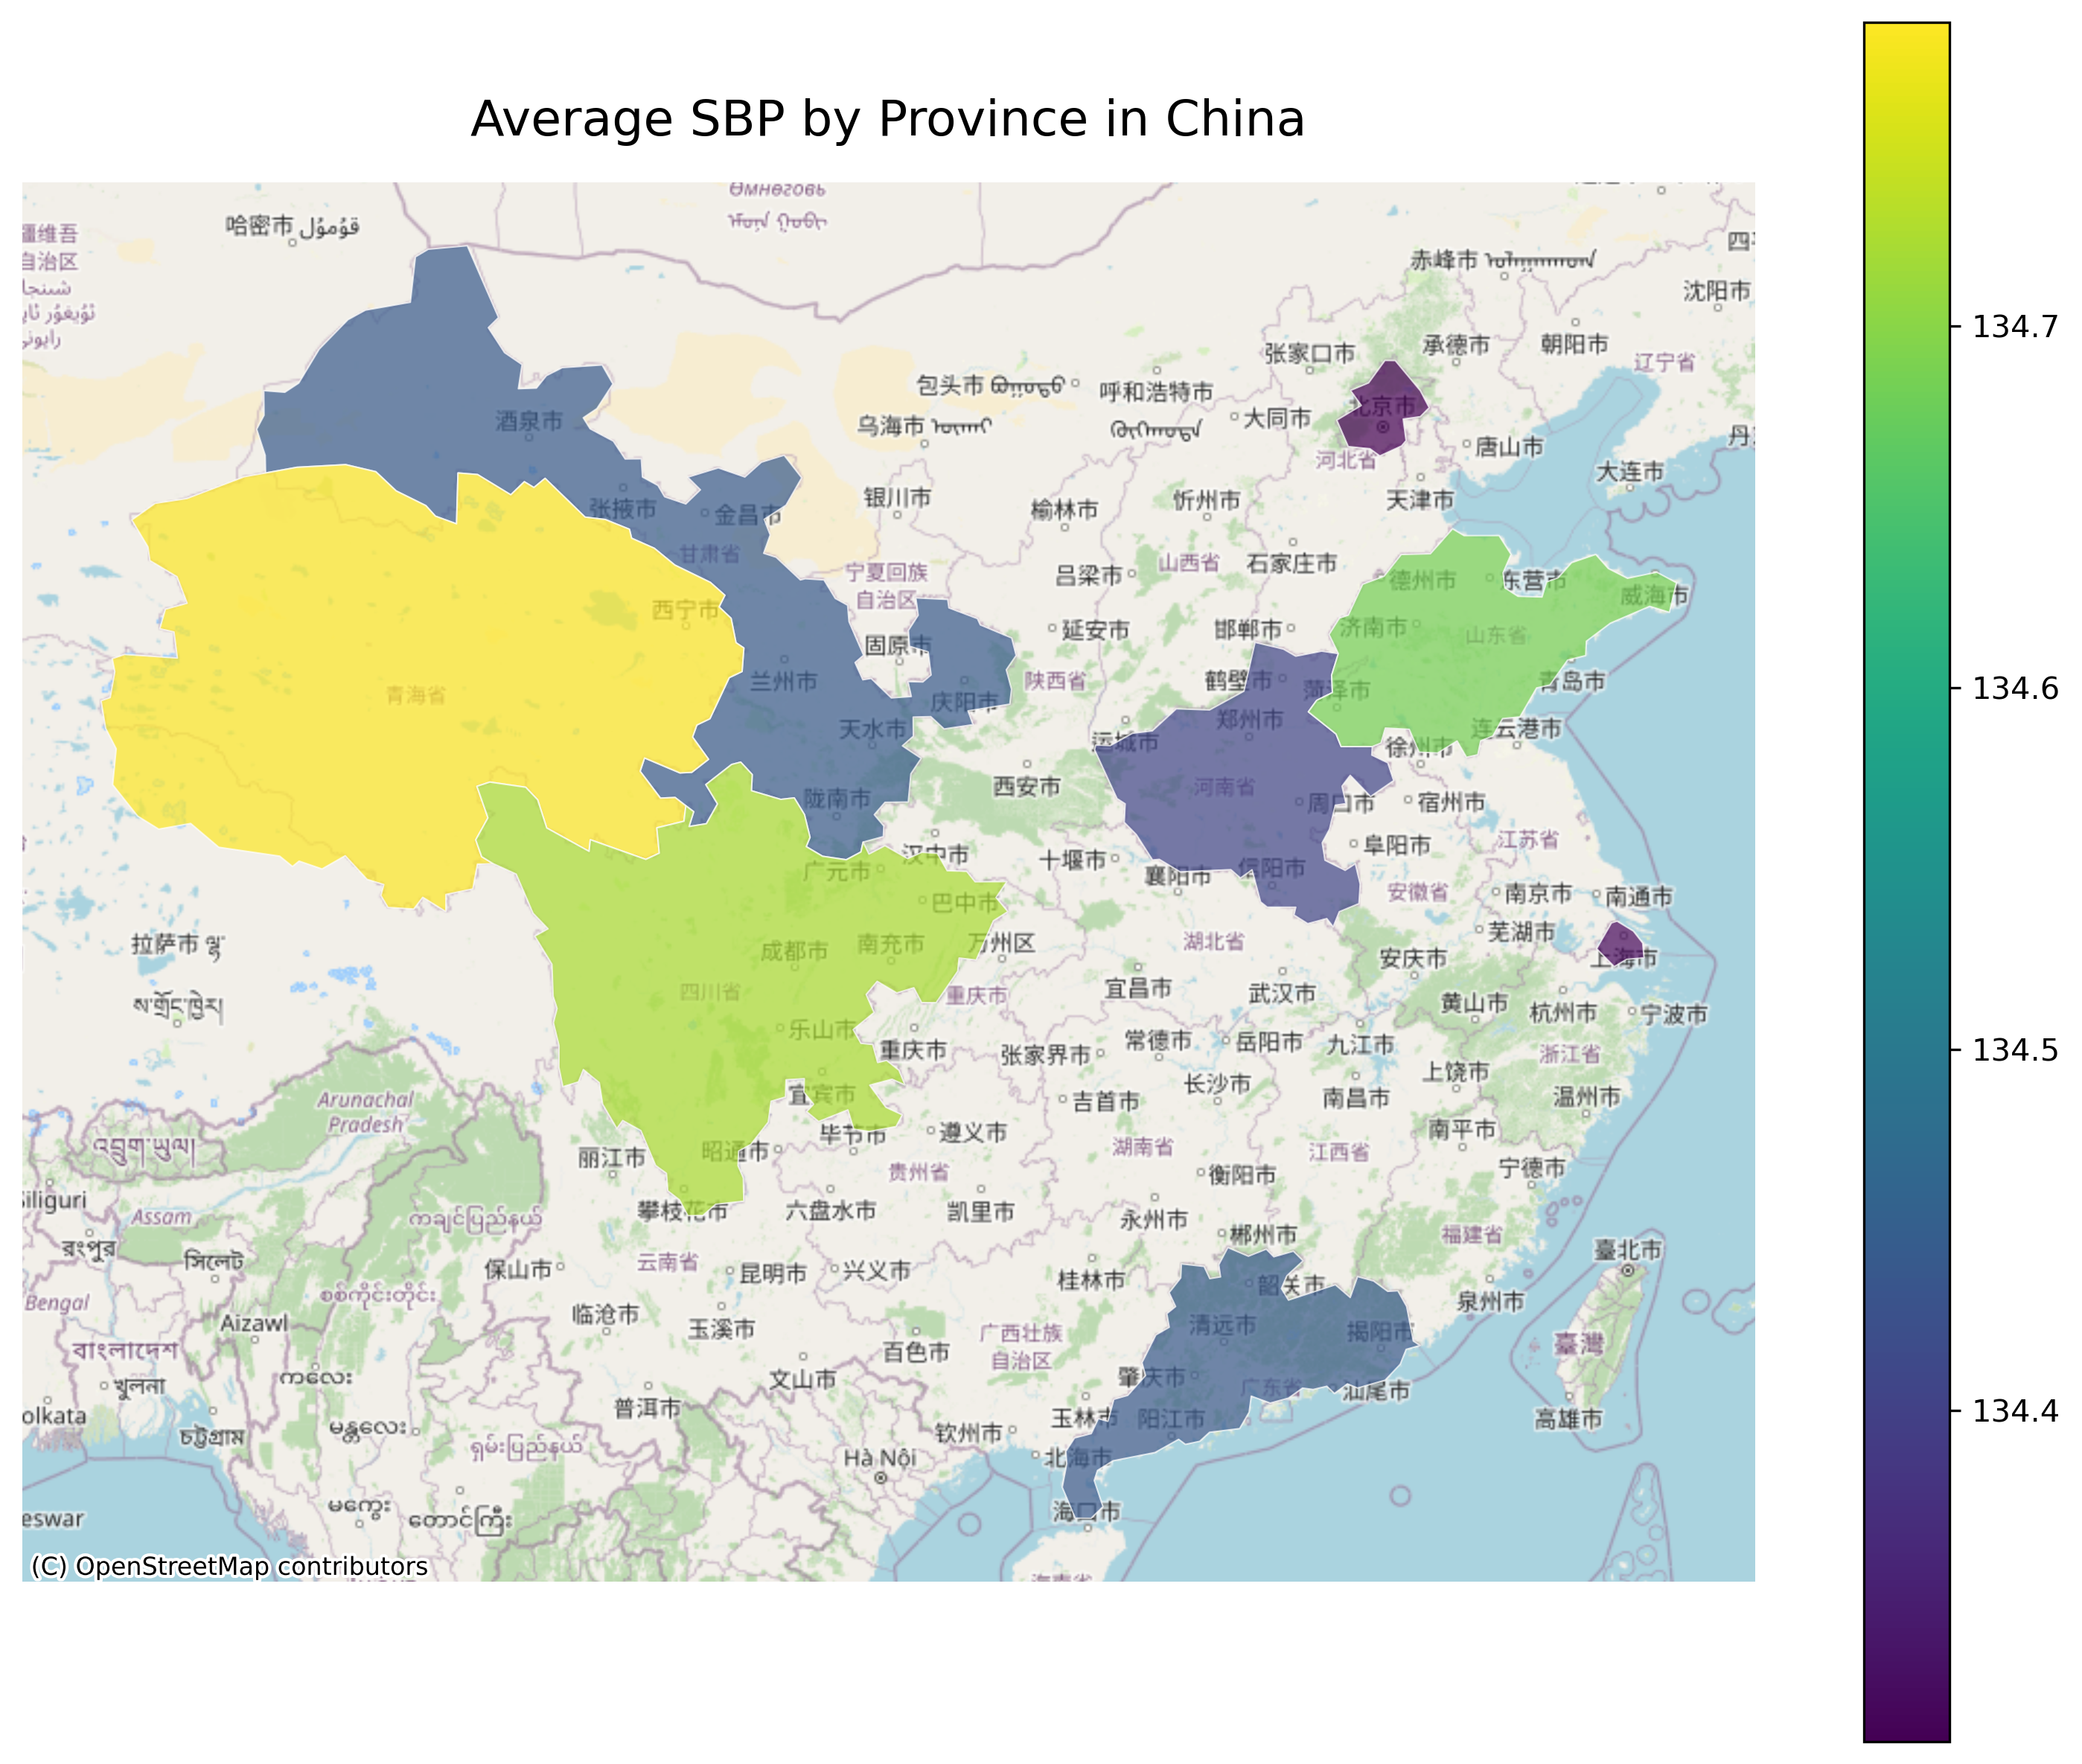
Each province is colored by its average heart attack rate.
Rates range from 0.119 (11.9%) to 0.123 (12.3%).
Lighter colors represent higher heart attack rates.
Geographic variation suggests regional factors may influence risk patterns.
Measures the pressure in arteries when the heart beats.
Is a major clinical risk factor for cardiovascular disease.
Higher SBP = increased risk of hear attack and stroke.
Values range from 134.4 to 134.7+ mmHg
Notes:
Here, the map on the left, we’re looking at the average heart attack rate across different provinces in China. Each province is shaded based on its relative rate, with darker purples indicating lower values and brighter greens and yellows indicating higher values.
The numeric scale on the right shows the range of rates in our dataset, which falls between about 11.9% and 12.3%. Even though the range is narrow, these differences are meaningful at a population level and may reflect regional influences such as lifestyle, environmental factors, or access to healthcare.
This visualization helps us quickly identify which provinces stand out and where deeper analysis may be needed.
“The map on the right, shows the average systolic blood pressure across provinces in China. Each province is colored based on its SBP value, with darker blues indicating lower averages and lighter greens and yellows indicating higher averages.
The values range from roughly 134.4 to 134.7+ millimeters of mercury. Even though this is a narrow range, small differences in blood pressure can still have meaningful population-level effects.
This visualization helps us identify regions where elevated blood pressure may contribute to higher cardiovascular risk.”

Slide 8
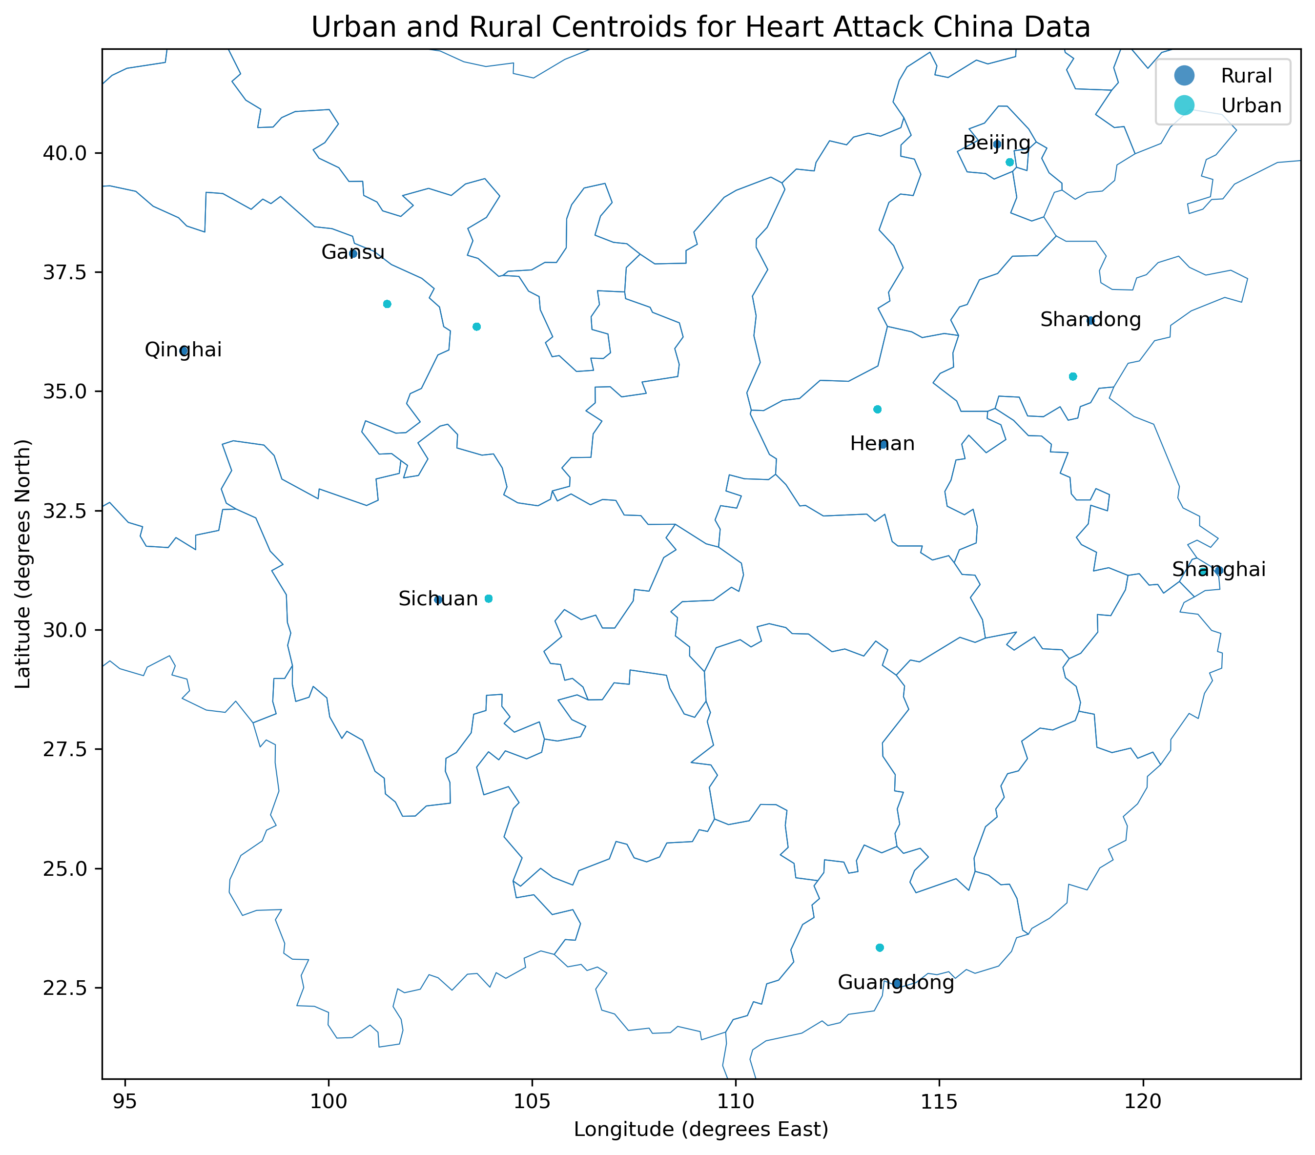
Map shows urban vs. rural population centroids derived from our dataset
Teal markers represent urban participants; blue markers represent rural participants.
Centroids indicate general geographic distribution of each population group across provinces
Provides spatial context for understanding regional patterns in heart attack rates and blood pressure
Notes:
Here we’re looking at a map showing the geographic centroids of the urban and rural participants in our dataset. Each teal point represents the average location of urban participants, while the blue points represent rural participants. These centroids aren’t meant to show exact cities, but rather the general spatial distribution of our sample across the provinces.
The map helps us understand where each population group is concentrated and provides useful context as we interpret differences in heart attack rates and blood pressure. It also highlights that urban and rural groups are not distributed identically, which may contribute to differences in risk factors across regions.

Slide 9
Constructed Dataset – How can we use it?
Regional risk patterns
Age distribution
Gender differences
Lifestyle and clinical factors

Slide 10
Distribution Approach
Clone repository
Retrieval process documented for ease of reproducibility
Standard folder structure used
Save as CSV to minimize ingestion friction and maximize readability

Slide 11
Potential Users and Applications
Users
Hospitals, cardiology departments, public health analysts, professors, and students
Applications
Developing predictive models for risk assessment, improving existing models, assist with early diagnosis and treatment methods

Slide 12
Challenges and Limitations
No timestamp information. Without dates for patient events or data collection, we could not analyze trends over time or establish temporal relationships.
Heterogeneous data sources. Combining Kaggle, WHO, air quality, and OSM data introduced alignment issues, especially around province naming and missing content.
Limited medical domain expertise. Interpreting some clinical indicators required additional research and conservative methodologic choices.
Potential sampling bias. The dataset’s representativeness across provinces and demographics is uncertain, which may influence generalizability.
Notes:
We faced several challenges while preparing the dataset. The first was data limitations: the original Kaggle dataset did not include timestamps, so we weren't able to analyze changes over time, and it also lacked a data dictionary. This meant we had to manually interpret several variables and validate our assumptions.
We also worked with multiple heterogeneous sources, Kaggle, WHO, OpenAQ, and OSM, which required careful alignment of province names and formats before merging them.
Finally, since none of us have a medical background, we had to be conservative in how we interpreted clinical indicators like blood pressure, lifestyle factors, and risk flags.
These challenges shaped how we cleaned the data and how cautious we were in framing our conclusions.

Slide 13

Thank you
Roy Phelps, Shad Scarboro, Leland Weeks, Evan Wessel

